Slide 1
Gravitational Force
Year 7 Science

Slide 2
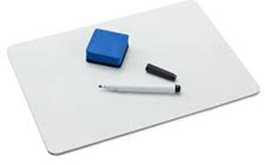
Review
Draw an example of useful friction | Draw an example of non-useful friction
Convert 100N to kg | Explain why mass creates more friction

Slide 3
Learning Intentions
Earth’s gravity pulls objects towards the centre of the Earth.
investigating common situations where forces are balanced, such as stationary objects, and unbalanced, such as falling objects
exploring how gravity affects objects on the surface of Earth
considering how gravity keeps planets in orbit around the sun

Slide 4
Success criteria
Classify gravity as a non-contact force.

Slide 5
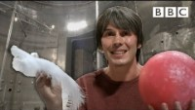

Slide 6
Activity/Worksheet:
Gravity Experiments for Kids - Galileo and Isaac Newton (science-sparks.com)

Slide 7
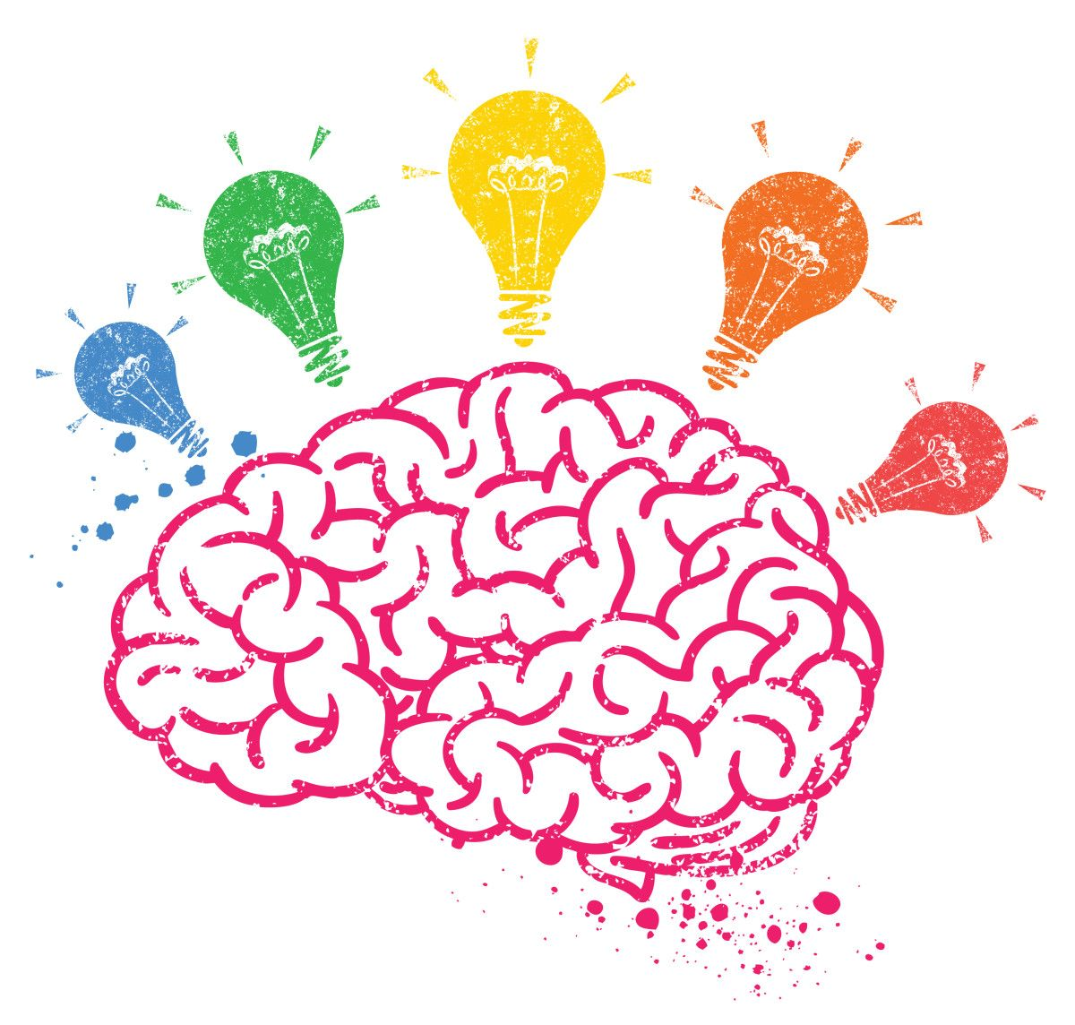
Activity/Worksheet:

